Slide 1
Capstone Presentation - Customer Churn prediction Model
BY:- Harsh Patel
BATCH: PGPDSBA.O.JAN 24
Post Graduate Program in Data Science and Business Analytics

Slide 2

BUSINESS PROBLEM UNDERSTANDING
Business Objective:
An E Commerce company going through a challenging phase of retaining customers keeping in mind the current market situation and high market competition and to stand by this the company wants to develop a model through which they can customer churn and provide segmented offers to the potential churners. In this company, we observed that one account have multiple customers which indicates that losing one account may lead to losing multiple customers.
Therefore, We as a data analyst are consulting the firm for developing a model which could provide better churn prediction so that they can make necessary changes in their business model and customize marketing and advertising campaign to retain the customers and add new customers.

Slide 3
MODELLING WORKFLOW:
Model evaluation criteria – Good fit, Interpretable, F1 Score, Precision, Recall for 1s
Visual inspection
Observe rows & columns, understand attributes, data types, nulls
Perform data cleaning
Statistical description
7 Algorithms selected
Classifier versions from SKLearn and Statsmodel
Base model with default hyperparameters
for benchmarking
EDA
Perform univariate and bivariate analysis
Anova and Chi-squared test
Correlations between variables
Performance improvement
Data changed for different trials
Hyperparameters tuned (Grid Search)
Regularization
Ensembles
Data Preparation
Remove unwanted variables (Account ID)
Missing value treatment
Outlier treatment
Variable transformation (Encoding)
Best model within each algorithm selected based on evaluation criteria
Pre- processing
High VIF variables removed (Cashback, Service Score, Clusters, User Count)
Train-test split in 70:30 ratio
Scaling
Model performance comparison across best models of all algorithms
Modelling
Try out different models & evaluate performance on train and test
Benchmark base model performance
Tune hyper parameters and change data
Select best model based on evaluation metrics
Decide best model

Slide 4

KEY INFORMATION ABOUT DATA
Shape
Dataset contains 11260 rows and 19 columns
5 float
2 integer
12 object
Nulls
- 4361 total nulls in all predictor fields
- 2.28% of all predictor fields
Duplicates
0 duplicates in the dataset
Data clean up
-10 attributes required clean-up
- Special characters such as #, &, +, $, @ present
- Different representations of same category present. E.g., Male and M, Female and F
Target variable
-Churn = 1 (Churned customer)
Churn = 0 (Active customer)
-16.8% churned customers in dataset
- Class imbalance
Outliers
- 2658 outliers in numeric continuous columns
- Constitutes 1.4% of all predictor fields

Slide 5
MODEL APPROACH USED & WHY?
Exploratory Data Analysis for Churn Prediction: Explore datasets and analyze customer churn in an e-commerce or DTH company to develop models for predicting and addressing potential churn.
Importance of Reducing Churn: High churn rates are costly for businesses, impacting growth. Even small increases can compound over time and impede growth.
Customer Retention as Essential: Retaining customers is crucial for financial stability and market sustainability. Churn analysis is necessary to mitigate financial losses.
Identifying Product Weaknesses: Churn analysis reveals patterns and motivators for customer departure, helping companies understand product weaknesses and improve accordingly.
Discovering Customer Opportunities: Understanding customer requirements at each stage of their journey enables personalized engagement, enhancing customer satisfaction and loyalty.

Slide 6
MODEL APPROACH USED & WHY? (cont.)
Impact of Churn: Customer churn negatively affects businesses, making prediction and retention crucial.
Train-Test Split: Allocate 70% of data for training and 30% for testing to ensure models learn from known data and perform well on unseen data.
Models & Techniques:
Logistic Regression (basic/tuned, SMOTE)
Linear Discriminant Analysis (basic/tuned, SMOTE)
K-Nearest Neighbors (basic/tuned, SMOTE)
Naïve Bayes (basic/tuned, SMOTE)
Random Forest (basic/tuned, SMOTE)
Bagging, AdaBoost, Gradient Boosting) (basic/tuned, SMOTE)
Support Vector Machines (basic/tuned, SMOTE)

Slide 7
INTERPRETATION OF THE MOST OPTIMUM MODEL (INSIGHT FROM ANALAYSIS) -
Models | Training Dataset (70%) |  |  |  |  |  |  |  | Testing Dataset (30)%
Performance Metrics | Precision (0) | Recall (0) | F1-score (0) | Precision (1) | Recall (1) | F1-score (1) | Accuracy | AUC Score | Precision (0) | Recall (0) | F1-score (0) | Precision (1) | Recall (1) | F1-score (1) | Accuracy | AUC Score
Bagging with SMOTE | 1 | 1 | 1 | 1 | 0.99 | 0.99 | 1 | 0.99 | 0.96 | 0.97 | 0.97 | 0.86 | 0.82 | 0.84 | 0.95 | 0.9
KNN with Hyper Tuning | 1 | 1 | 1 | 1 | 1 | 1 | 1 | 1 | 0.97 | 0.99 | 0.98 | 0.92 | 0.82 | 0.87 | 0.96 | 0.96
Random Forest with SMOTE | 1 | 1 | 1 | 1 | 1 | 1 | 1 | 1 | 0.97 | 0.98 | 0.98 | 0.9 | 0.85 | 0.88 | 0.96 | 0.98
SVM Model with Hyper Tuning | 0.96 | 0.99 | 0.98 | 0.96 | 0.81 | 0.88 | 0.96 | 0.99 | 0.94 | 0.98 | 0.96 | 0.9 | 0.71 | 0.79 | 0.94 | 0.95
Top Models: The best-performing models showed strong precision and recall but also suggested potential overfitting. These models include:
Bagging with SMOTE
K-Nearest Neighbors (KNN) with Hyper Tuning
Random Forest with SMOTE
Optimum Model - SVM with Hyper Tuning:
Balanced Performance: Achieved a consistent precision-recall balance on both training and test datasets.
Overfitting Resilience: Demonstrated strong adaptability to new data, minimizing the risk of overfitting.
From the evaluated models, the "SVM Model with Hyper Tuning" offers a well-balanced and reliable churn prediction, making it a practical choice. However, further regularization is required to enhance recall.

Slide 8
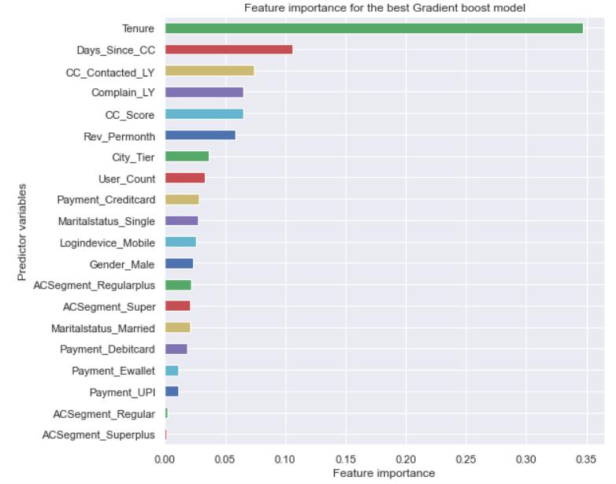
Top predictors for the best model
Tenure has the highest influence on the model – contributes 35% of all attributes feature importance. Low tenure (<2) has the highest churn
The next 4 features together contributes to 31% of importance
1 Days since customer care contact - 11%
2 Number of times customer care was contacted last year –7%
3 Whether a complaint was made last year or not – 7%
4 Customer care agent score – 6%
The Revenue per month predictor is 6th important one - 5.5% contribution.
These are all related to customer care and service. Points to scope for improvement

Slide 9
DETAILED RECOMMENDATIONS
From EDA and Model

Slide 10

ONBOARDING/ACTIVATION PROCESS
Impact of Tenure on Churn: Both EDA and modeling indicate that tenure significantly affects churn rates.
Possible Reasons for High Churn:
Poor initial experience.
Trial periods or prepaid accounts expiring without timely top-ups.
Determining the Cause:
High customer care calls, complaints, and low cashback/coupons for short-tenure customers suggest the cause is poor initial experience.
Proposed Solutions:
Extended Support: Activation/onboarding team should provide continued support beyond initial setup until customers are comfortable with the service.
Proactive Engagement: Activation team should actively engage with customers during the first month or two.
Feedback Survey: Customer care should conduct feedback surveys to identify and address any issues in the onboarding process.
Incentives for Feedback: Offering gift cards or coupons to increase response rates for feedback.

Slide 11

COMPLAINT ANALYTICS AND MANAGEMENT
High Churn Rate Among Complaining Customers: Customers who register complaints churn 182% more than those without complaints.
Possible Reasons:
Complaints not resolved on time or to customer’s satisfaction.
Proposed Solutions:
Analyze Complaints: Identify top reasons for customer complaints.
Address Root Causes: Focus on resolving the root causes of the top complaints.
Establish SLAs: Create Service Level Agreements to track and ensure timely resolution of complaints.
Proactive Engagement: Provide status updates to customers until their complaint is resolved.
Feedback Collection

Slide 12
REVIEW CUSTOMER CARE AND SERVICE PROCESS
Low Service and Customer Care Ratings:
78% of customers rated the service as 3 or less out of 5.
61% of customers rated customer care agents as 3 or less out of 5.
Possible Reasons for Low Scores:
Service score issues might be due to technical problems, plan structure, or insufficient support from activation and customer care teams.
Customer care agent scores could reflect agent behavior (e.g., knowledge, disposition) or procedural issues (e.g., call wait time).
Recommendations:
Conduct a root cause analysis (Pareto) of feedback associated with low scores.
Address the root causes contributing to the primary reasons for low feedback scores, which may also reveal reasons for churn.
Modify the process to capture verbal feedback if it is not currently being recorded.

Slide 13
REVIEW CURRENT RETENTION SPENDS
Median Cashback Analysis: Active customers receive 10% more cashback compared to churned customers.
Coupon Usage: Both churned and active customers have used the same number of coupons.
Possible Reasons:
Retention programs may not be effectively targeting customers at risk of churn.
Existing programs may have successfully reduced churn in a previously high-risk segment, altering the current risk profile.
Recommendations:
Review the relevance of existing cashback and coupon programs in light of the current churn model.
If they are no longer effective, design new retention programs aimed at the current high-risk customer group.

Slide 14
THANK YOU!

